Slide 1
Technical Assistance
Please be aware that due to the demands of moderating the webinar we
are not able to respond to individual requests for technical support 30
minutes prior to and during the webinar presentation. If you experience
technical difficulties during this time, you can join us by teleconference.
Thank you!
Teleconference Line to listen:
Toll-free number: 1-888-453-4221
PARTICIPANT ACCESS CODE: 860544
Notes:
Moderator

Slide 2
Open Sesame! – A Touch-Free App
Presented by:
Shai Eilat, Head of Sesame Enable’s U.S. Operations
Monday, July 2nd: 2:00 PM – 3:00 PM PST
This webinar training is provided by Ability Tools and California Foundation for Independent Living Centers
in partnership with the Department of Rehabilitation.
© 2017 – Ability Tools– All rights reserved
Ability Tools materials may be reproduced for non-commercial purposes provided their source is identified.

Slide 3
Webinar Logistics
Audio can be accessed through the webinar platform or teleconference.
Webinar Audio – To set up audio, select the Audio Setup Wizard Icon or Tools>Audio>Audio Setup wizard. If you have a microphone, use the talk button to speak (located below the audio/video screen) during Q&A.
Teleconference – Switch to the teleconference by selecting the teleconference icon and calling in:
Toll-free number: 1-888-453-4221
PARTICIPANT ACCESS CODE: 860544
.
Notes:
Moderator

Slide 4
Webinar Logistics
If you’re on the teleconference line, please mute your line by pressing star (*) 6.
Please DO NOT put your line on hold, as it will create a background music.
During the Q&A, press star (*) 6 to unmute your line

Slide 5
Webinar Logistics
Closed-Captioning: cc icon above audio video screen or Ctrl + F8
Screen Readers: Window>Activity Window or Ctrl + Forward Slash
Raise Hand
Respond to Poll
Chat Box
Room tab to message everyone on webinar
Moderators tab to message moderators
Recording available within 7-14 business days
Notes:
Moderator

Slide 6
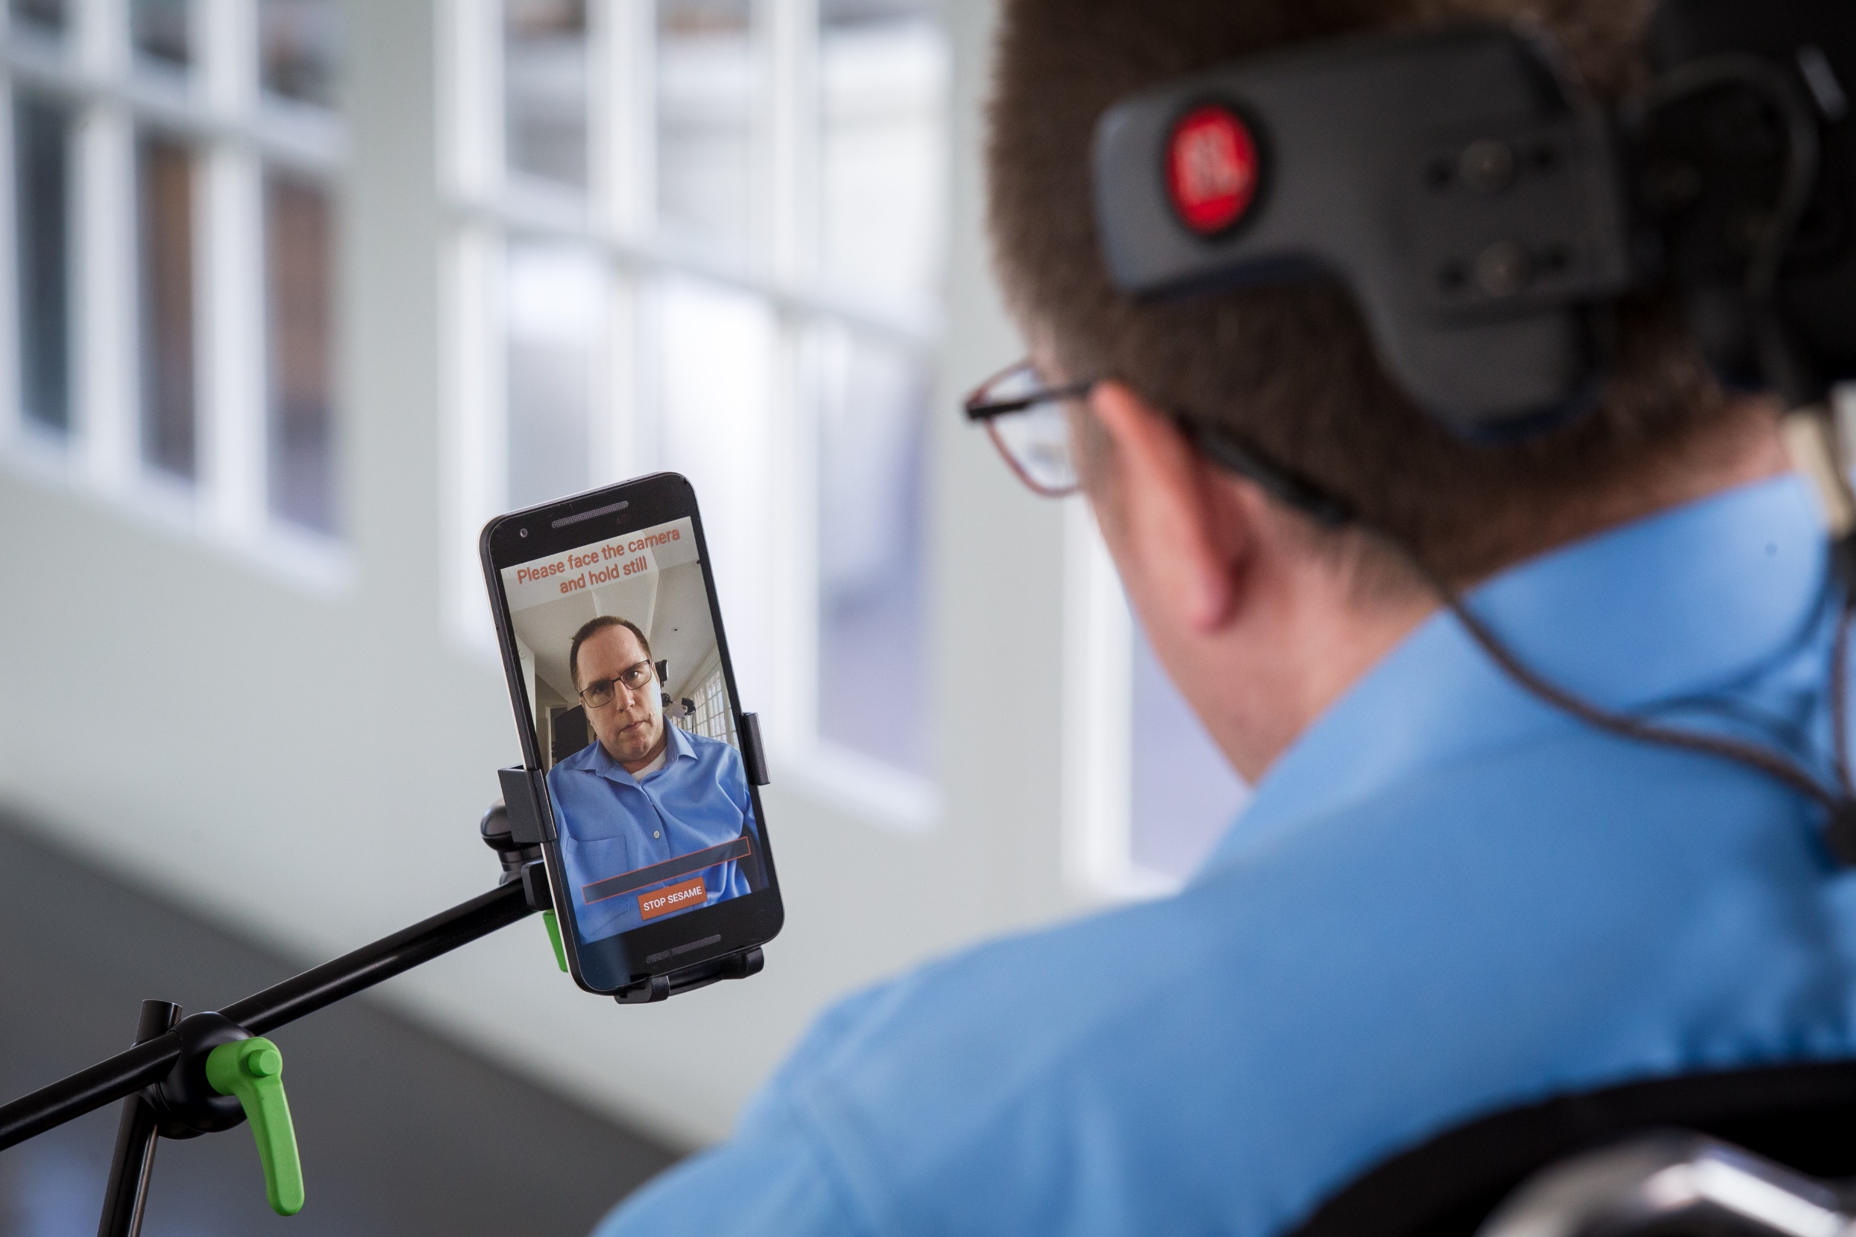
Shai@sesame-enable.com
(301)458-1990
www.sesame-enable.com

Slide 7
•
Founded by a quadriplegic electrical engineer and a computer vision expert
•
Bridging the gap between people’s physical abilities and the mobile revolution
Won a million dollars in Verizon’s Powerful Answers Award
Overachieved crowd funding campaign
On stage with President Obama at the Global Entrepreneurship Summit
FCC Chairman’s Award for Advancement in Accessibility
Awarded CES 2017 Innovation Awards Honoree in Accessible Tech

Slide 8
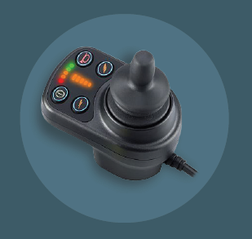
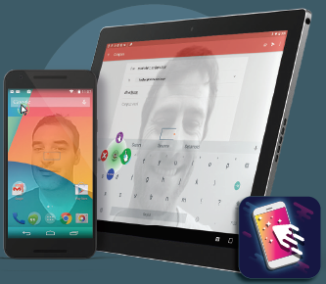
The Solution
Privately and independently communicate and interact
• World’s first complete Touch-Free mobile technology
An App on The Google Play Store
Advanced Image Processing
No Additional Software or
Hardware Needed
Full Control of All Smart Phone
and Tablet Applications
https://www.youtube.com/watch?v=EWC6iis--kY

Slide 9
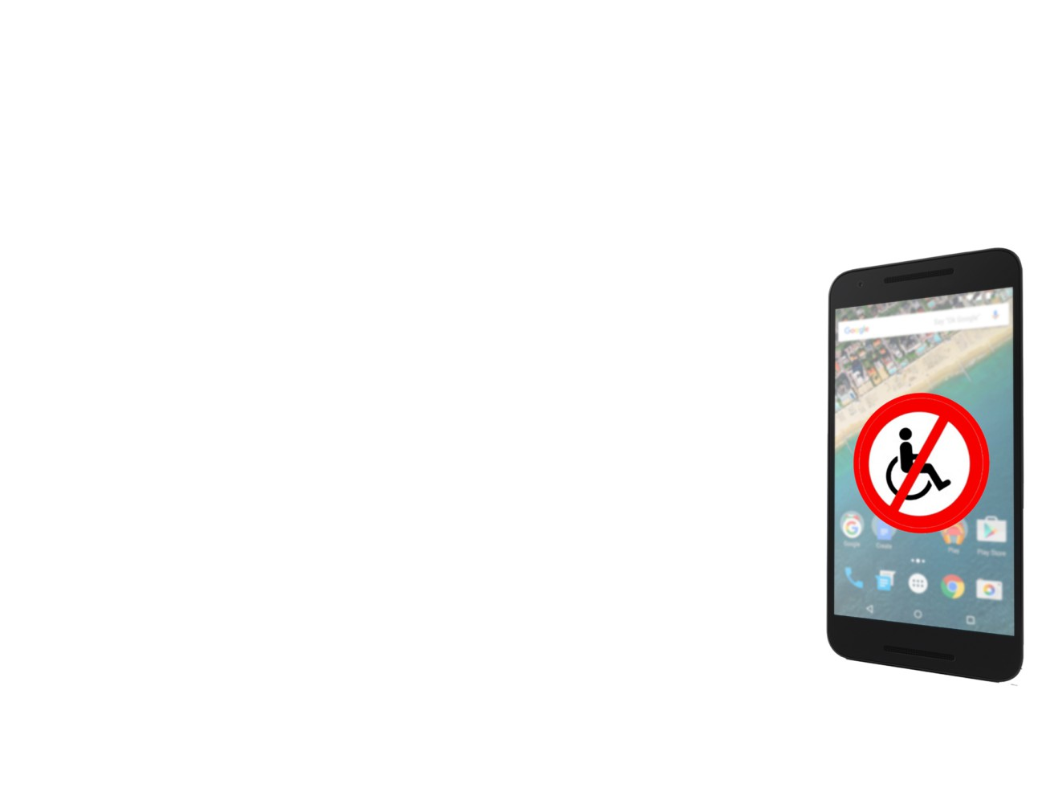
We solve a problem
More than 30 million people have been left out of the mobile revolution (More than 2 million in
the U.S.)
People whose condition denies the use of their hands:
Medical conditions: Spinal Cord Injuries, ALS, MS, Cerebral Palsy, Parkinson’s and more
Situational conditions: bed-ridden, hospitalization, and more

Slide 10
Demonstration

Slide 11
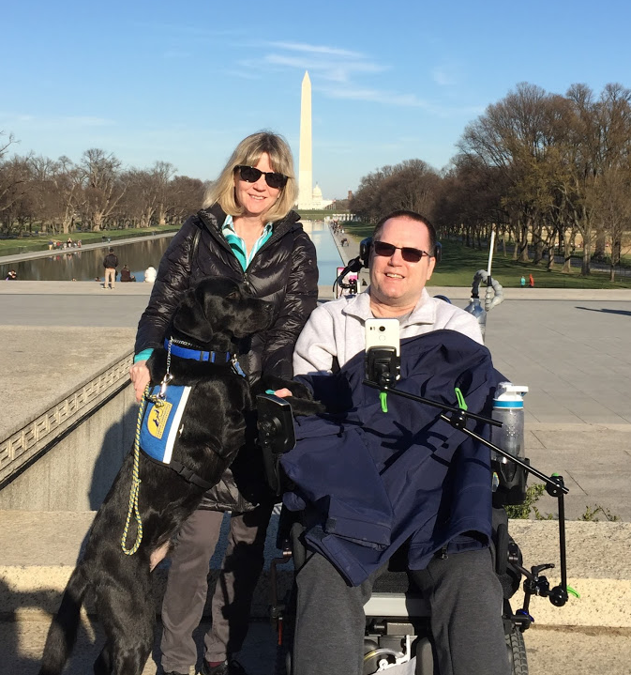
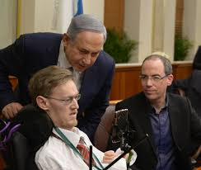
Sesame’s Impact
Gary Fisher
Alex Fridman

Slide 12
“Finally, FINALLY someone has developed
a truly hands-free smartphone that I can use.”
Thank You
shai@sesame-enable.com
www.sesame-enable.com

Slide 13
Recorded Webinar Training
This webinar training has been recorded. Please
allow 7-14 business days for the edited version to
be available and posted on Ability Tools AT Training
Library Web Page, Vimeo, and YouTube Channel.
You will receive an email with links to access the
recorded webinar training, presentation material,
and transcript.
Notes:
RP

Slide 14
Webinar Evaluation
We would appreciate if you would share your
experience with us by completing a survey at the
end of this webinar. Your feedback is highly valued
and participation is greatly appreciated for our future
webinar opportunities. When you exit the webinar
platform a pop-up training survey window will
appear.
Notes:
RP

